Slide 1
The R environment and the Three C’s
Persuasive Advice for Senior Management

Slide 2
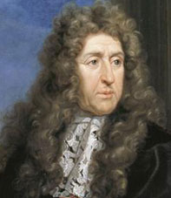

André Le Nôtre, The Gardens of Versailles
Notes:
Says André Le Nôtre, King Louis XIV’s landscaper of Versailles

Slide 3

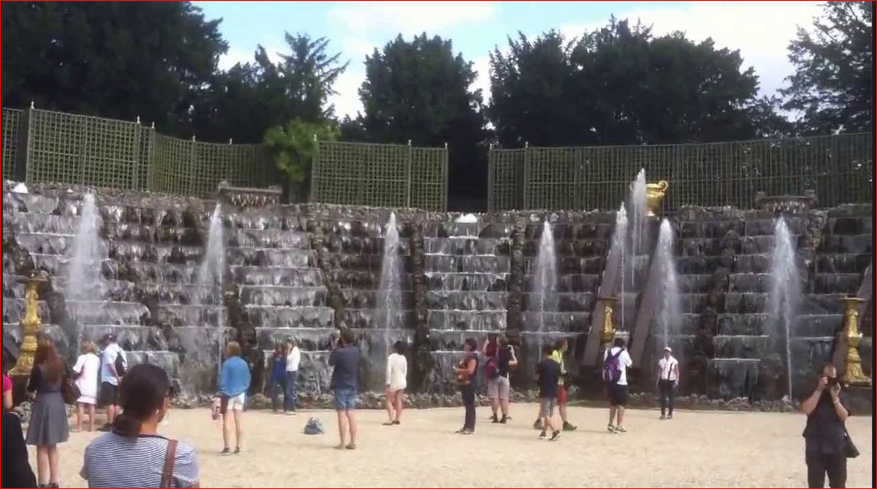
“I must confess to being a clay kicker myself” Passion is in our nature, A Little Chaos, 2014
Notes:
So says the fictional Sabine de Barra, protégé of André Le Nôtre, King Louis XIV’s landscaper of Versailles Salle de Bal at Versailles
A Little Chaos
A couple of years ago, average reviews (44% rotten tomatoes)
A story about the Gardens of Versailles
A story about a woman passionate about her work, a man who risked trust in her non-traditional ways, and a king whose concern his family’s unhealthy environment in Paris led to the Palace’s construction
http://www.telegraph.co.uk/culture/film/11542992/A-Little-Chaos-who-was-Andre-Le-Notre.html
When Louis ennobled him in 1675, he was asked what he would like on his coat of arms. He replied: "Three snails and a head of cabbage - but I must not forget my spade, for it is due to my spade that I am the recipient of all the kindness with which your Majesty honours me."

Slide 4
What is a tool?
A handheld device that aids in accomplishing a task
An apparatus used in the practice of a vocation or profession
Person of low intelligence, a fool
The tool is usually someone who is unwelcome but no one has the [discourtesy] to tell them to get lost
The tool is always making comments that are out-of-place, out-of-line or just plain stupid
A quiz follows
Notes:
http://www.merriam-webster.com/dictionary/tool for first two
http://www.urbandictionary.com/define.php?term=tool

Slide 5
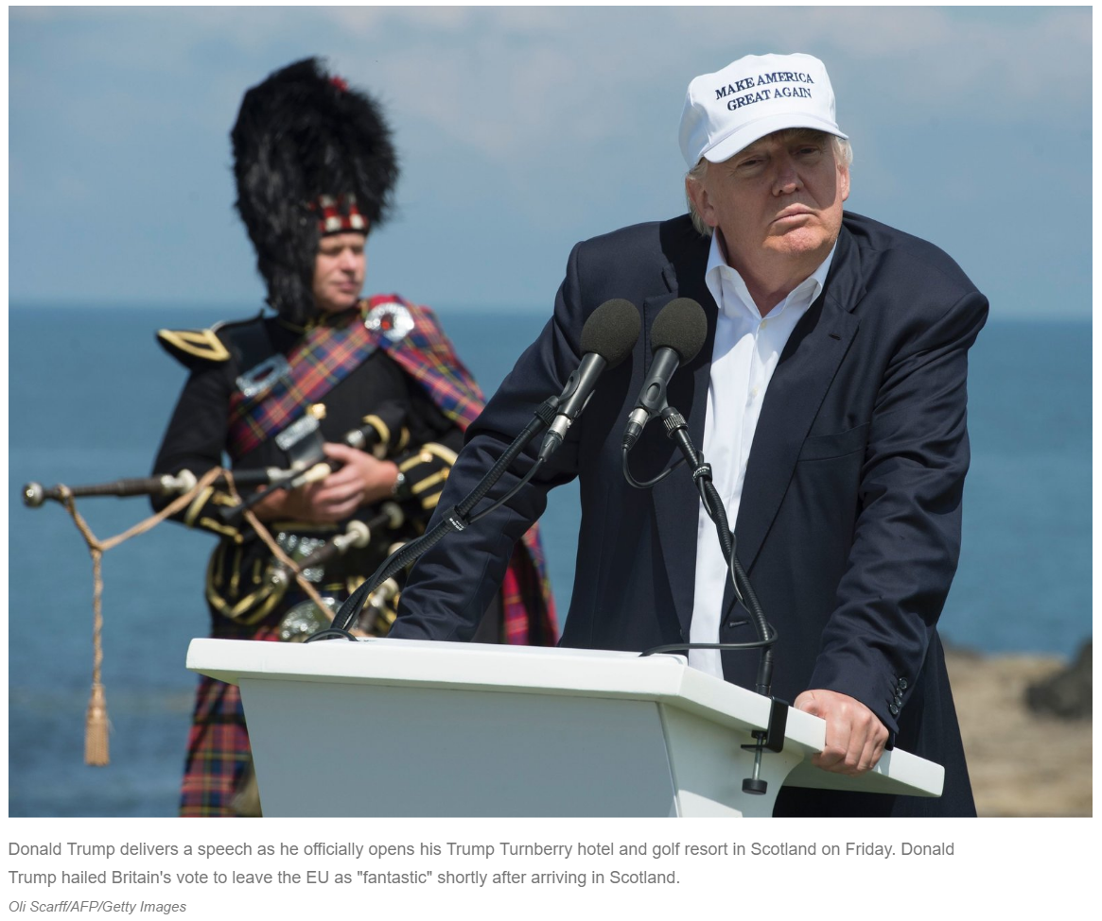
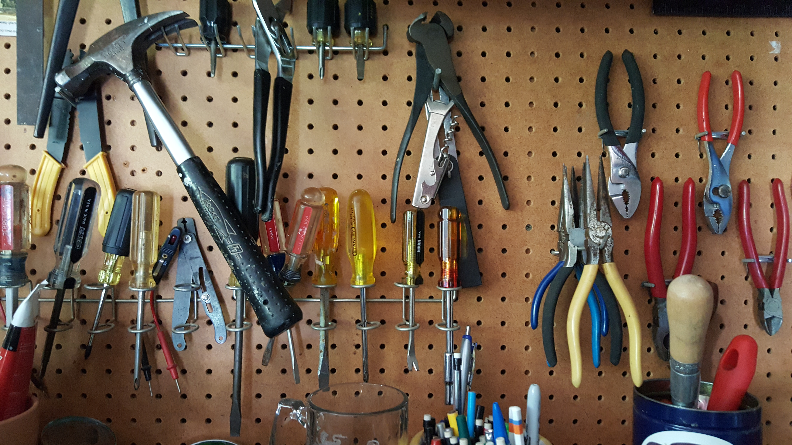
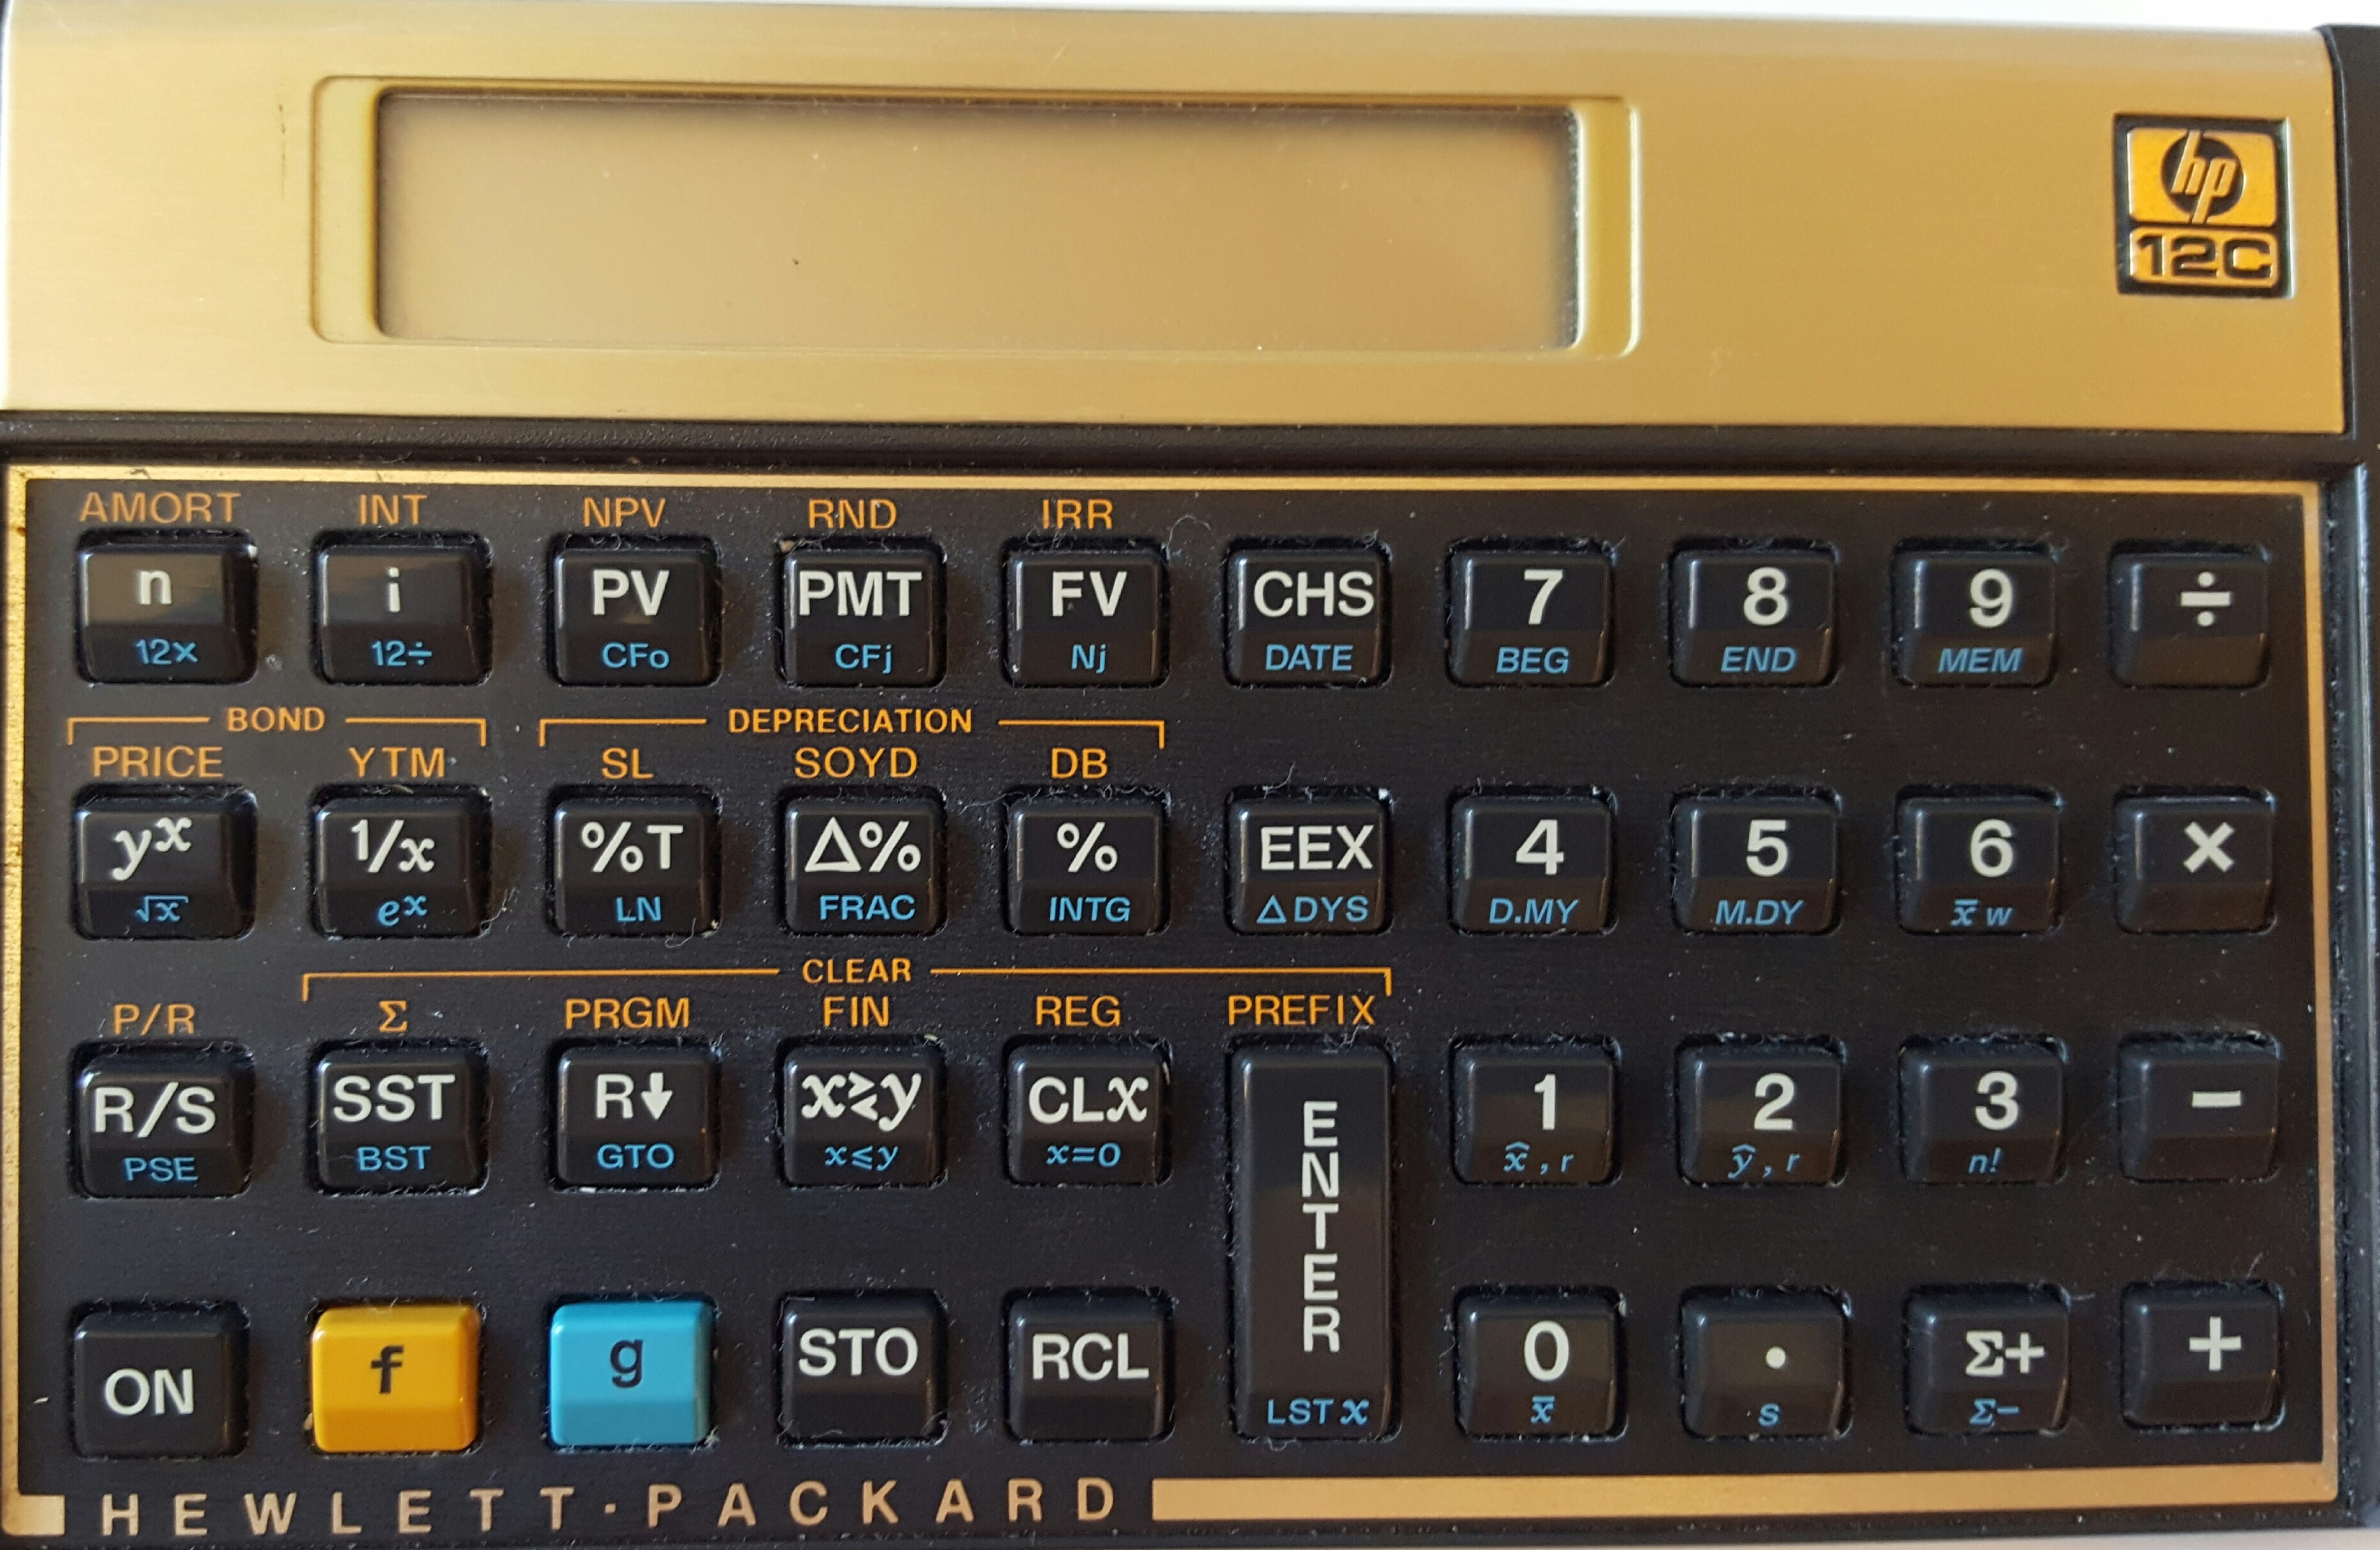



How many tools do you see?

Slide 6





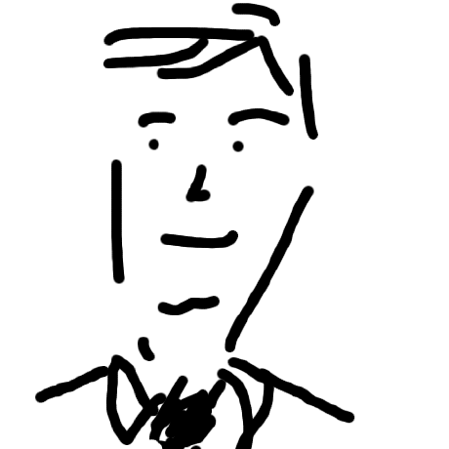
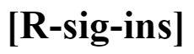



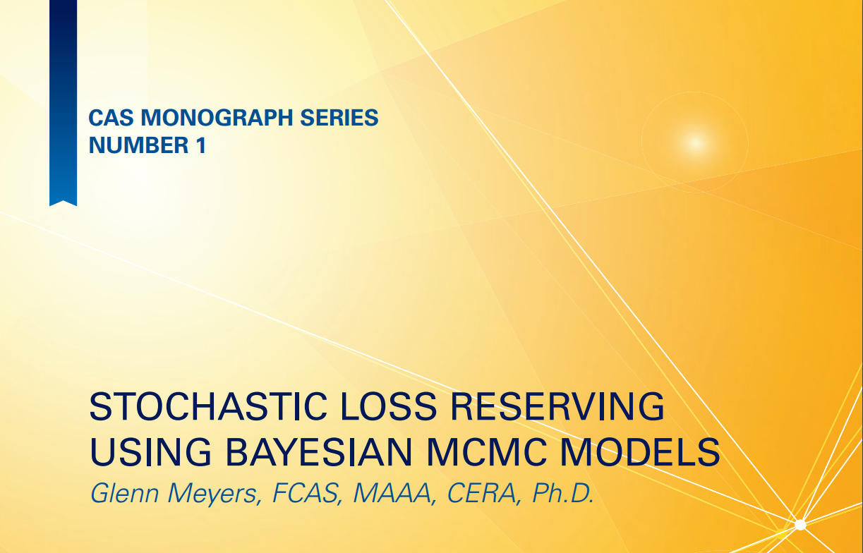




The “R Environment” is a collection of tools for the passionate analyst

Slide 7
Selling Senior Management: The Three C’s
Context
Can you articulate the problem
Confidence
Can you model the problem appropriately
Clarity
Is your analysis and advice actionable

Slide 8
The Three C’s
Context
What’s the question
Can you model the question mathematically
Confidence
Does your model hold up under peer review
Does your model hold up under inevitable alternatives
Clarity
Are your conclusions understood by the principal
Is your analysis and advice actionable

Slide 9
Context
Spreadsheets
Can prototype deterministic analysis relatively quickly
Sometimes so for stochastic analysis too
Example: Emmanuel Bardis’ Mack Method spreadsheet vs. ChainLadder package’s MackChainLadder
Context usually evolves as preliminary results become available
Management always asks “What if … ?”
Anticipate the question

Slide 10
Context
Do you understand the question, issue, problem?
Can you articulate the question, issue, problem in the principal’s language?
Can you articulate the question, issue, problem in mathematical language?
Can you express the mathematical solution in the principal’s language. (slang; lingo)

Slide 11
Context: examples
Identify the ambiguous terms in the following statements:
The value of incurred loss as of 2015-12-31 is ₤1 million
The age of accident year 2015 as of 2015-12-31 is 12 months
We all speak a different language … sometimes even when we are speaking the same language
Notes:
(Matt Dowle story – can you make a u turn here)

Slide 12
Confidence
Are you confident that …
Your calculations are correct?
Spreadsheet formula bust
Tech checkers
Program bug
Unit tests
Your data is correct?
Clean data is highly rewarding
Subject matter expertise
Your results are correct?
Peer review
Collaboration: github

Slide 13
Confidence: data quality examples
Policies
w <- which(duplicated(policy_id))
w <- which(policyExpirationDate <= policyEffectiveDate)
Claims
w <- which(duplicated(claim_id)
Policies and Claims
pc <- join(claimTable, policyTable, by = "policy_id", type = "left")
with(pc, …
w <- which(is.na(policyNumber))
w <- which(claimDate < policyEffectiveDate)
w <- which(claimDate >= policyExpirationDate)

Slide 14
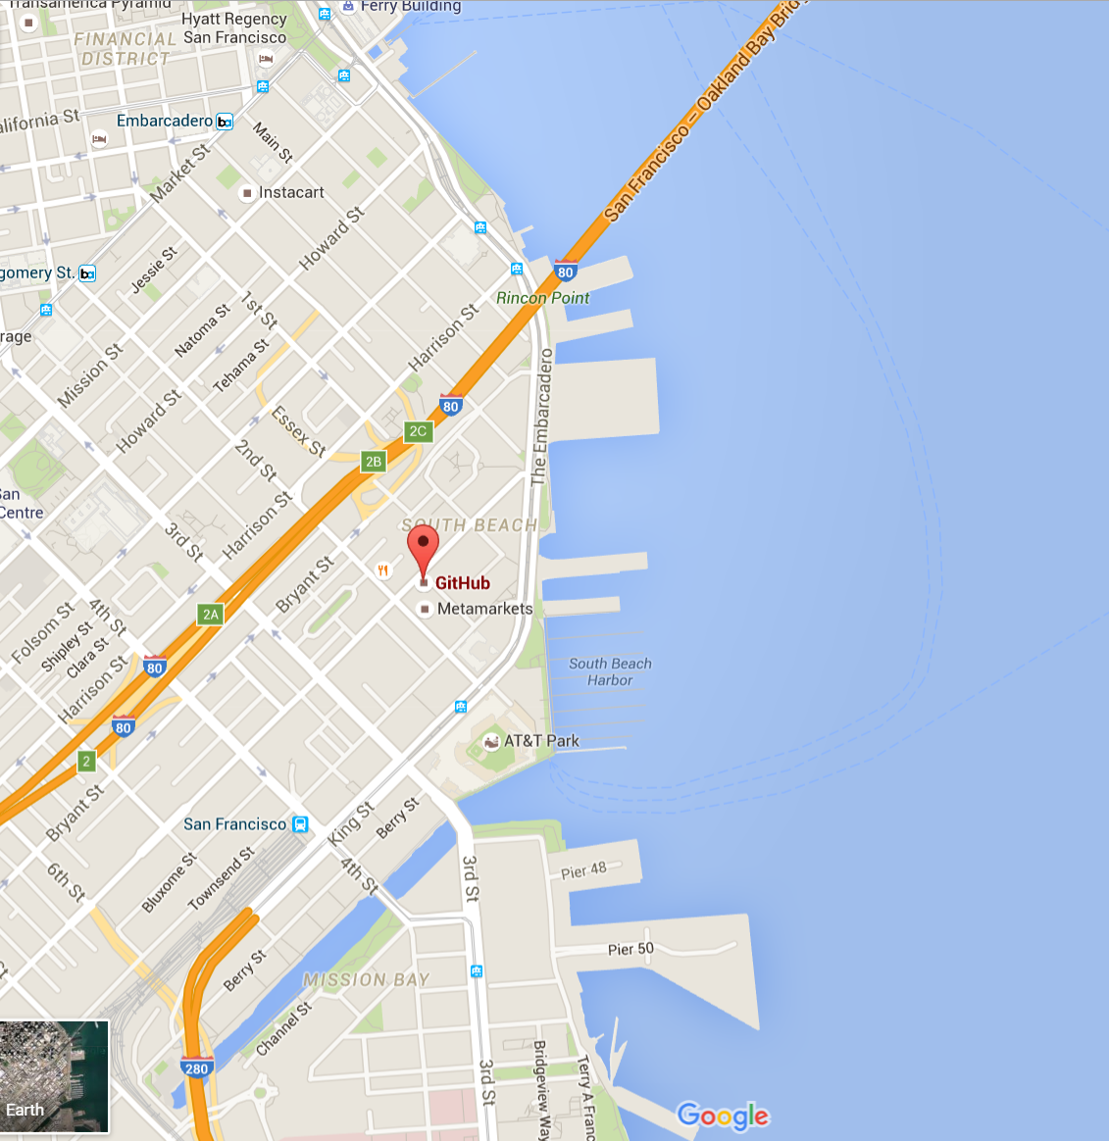
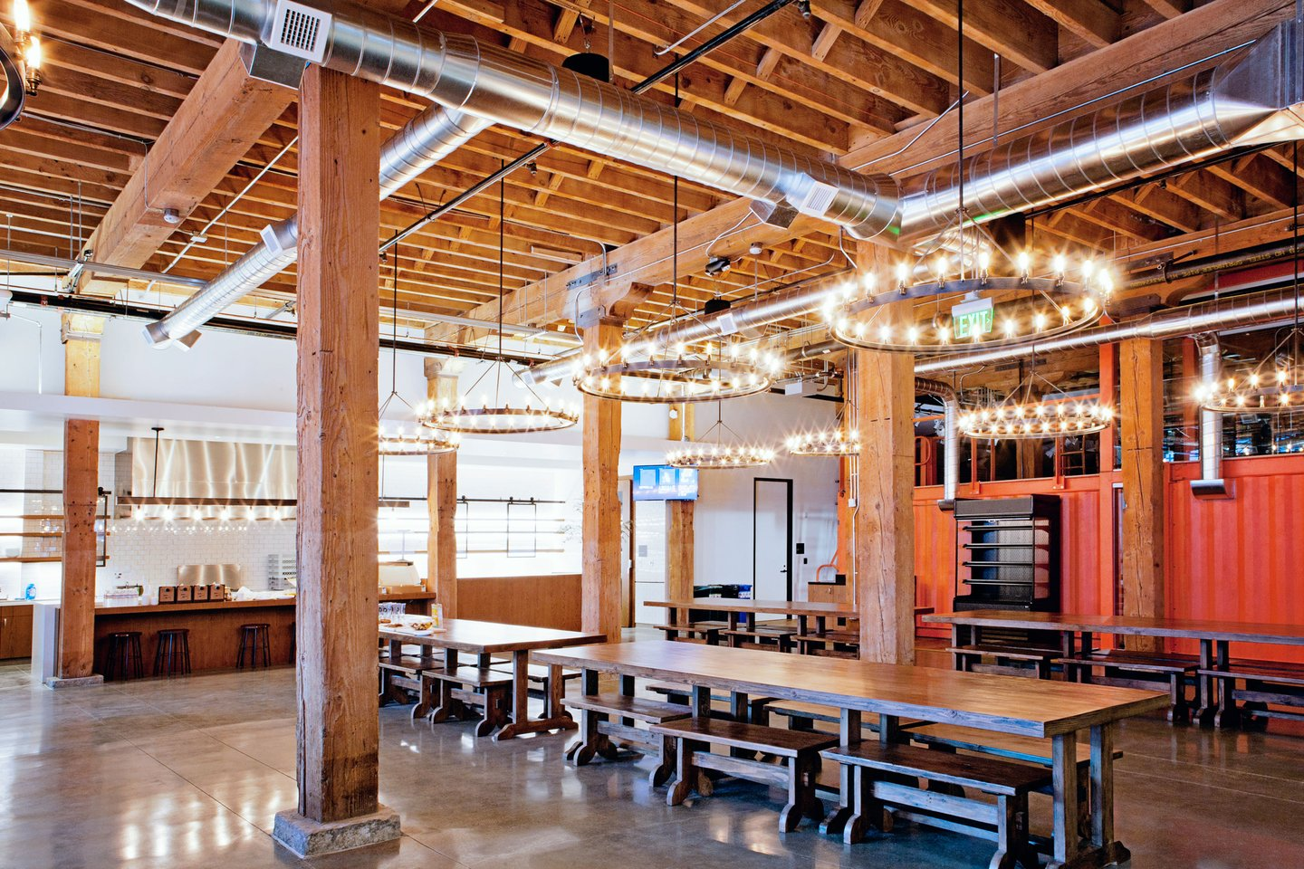
Collaboration: Github
Github

Slide 15
Clarity: Actionable Analysis
Management always asks “What if …?”
Visuals aid clarity
Notes:
Consistent results by country, line of business, other break-downs
M&A example: What if you jettison the unprofitable policies?
Reinsurance purchasing example: restate history

Slide 16
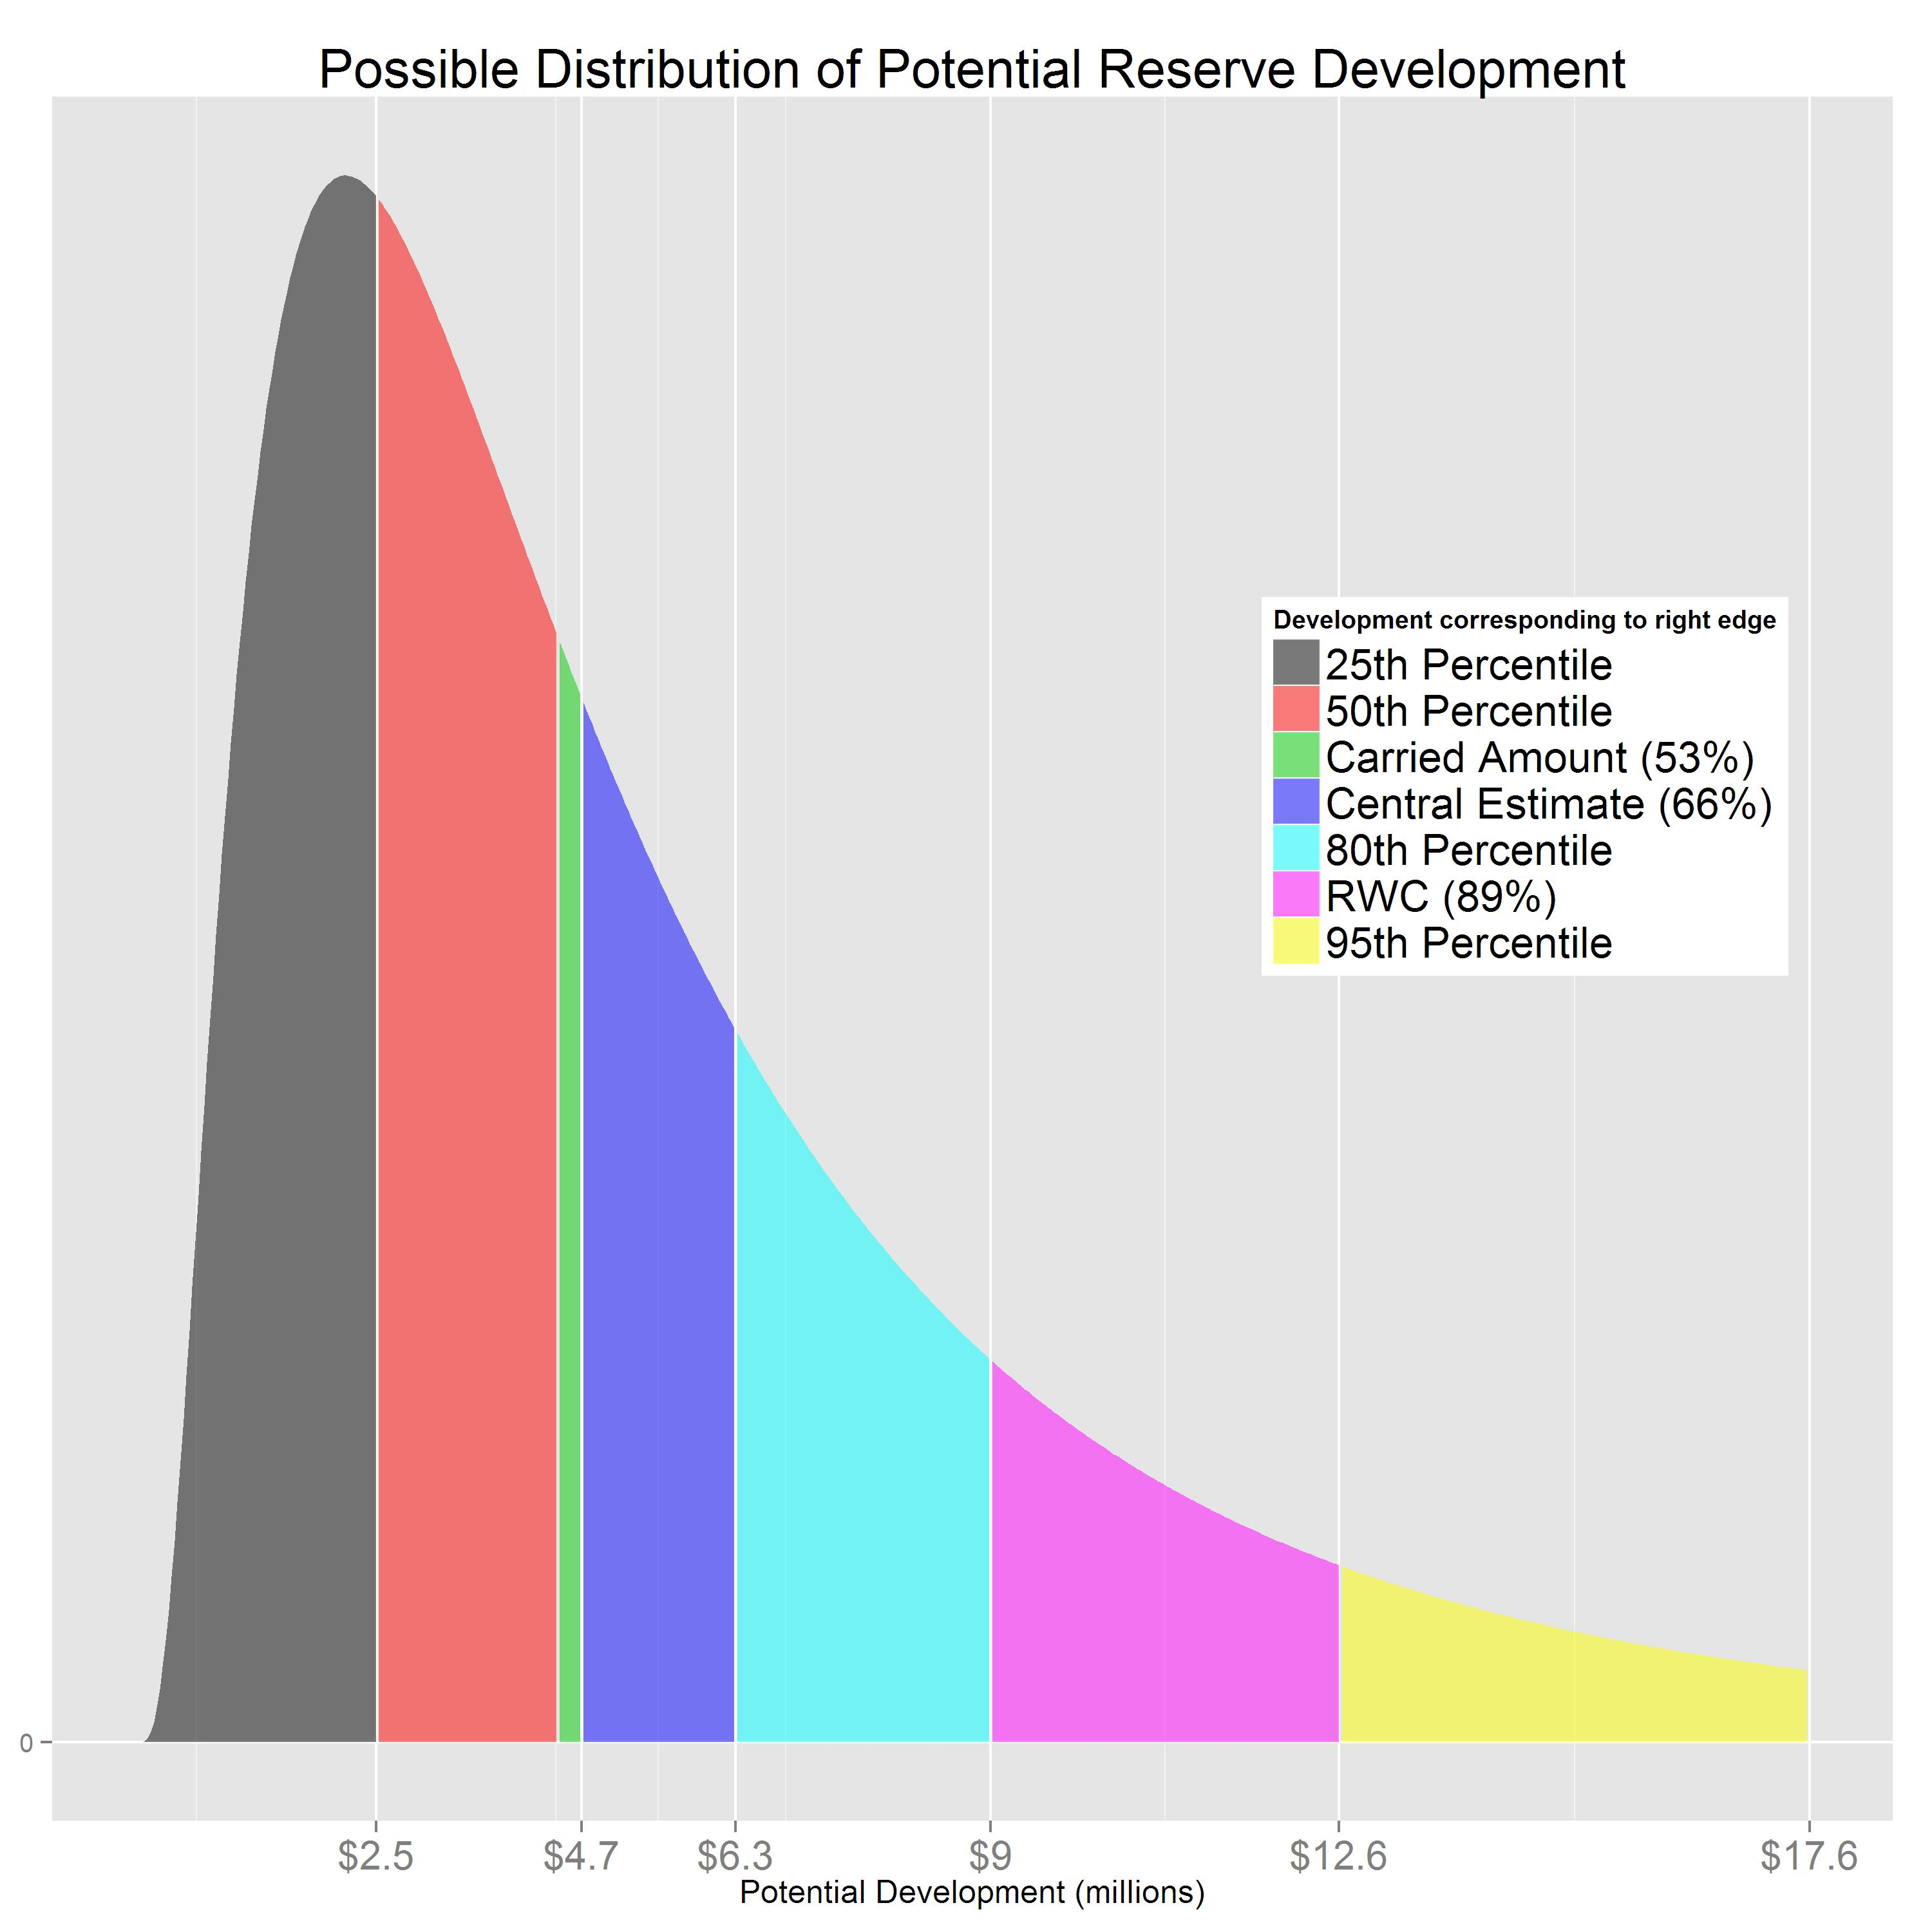
“Bell Curves”

Slide 17

Sabine de Barra advises the King
Spoken in the language of allegory

Slide 18

I must confess to being a clay kicker myself
Dan Murphy
Trinostics LLC San Francisco

Slide 19
Persuasive Advice for Senior Management: the Three C’s
You are the analyst whom Senior Management named to the 2016 strategic team. While collaborators and Management may not appreciate the technical foundations for your conclusions, how can you nevertheless persuade them to see the value in your message? Persuasive analysts use analytical tools that help them deliver advice with three C’s: Context, Confidence, and Clarity.
For decades, spreadsheets have been the insurance analytical tool of choice primarily because they can prototype models relatively quickly (high Context). But spreadsheets can be difficult to tech-check and audit (low Confidence) and time-consuming to modify for refocused objectives (low Clarity). More recently, R and derivative products are evolving into a computing tool that is particularly well-honed to deliver Three-C analytical advice to insurance Senior Management.

Slide 20
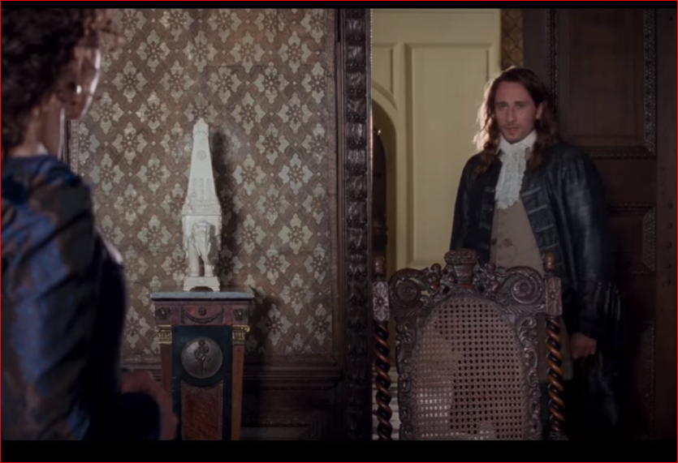
“I’m a Builder, Madame” André Le Nôtre, A Little Chaos, 2014
Notes:
Says André Le Nôtre, King Louis XIV’s landscaper of Versailles

Slide 21
Confidence
Spreadsheet “Tech-Checkers”
Back-story: time off, back to actuarial work, spreadsheets more entrenched than ever
Consistent formulas
Clean data
M&A work
Changes: Management inevitably asks “What if … ?”
Anticipate the question, re-run the analysis using different assumptions
Always see if you can get to the same answer two different ways
Curves
Being able to provide a probability distribution can increase one’s confidence in one’s own analysis

Slide 22
Confidence
The more you understand the mathematics behind your analysis, the more confidently you can articulate your advice in the language of the principal
R-Help
Mailing lists: R-Help, R-sig-ins, R-Devel
Blogs: R-bloggers, magesblog, …
The cleaner the data, the higher the confidence in your results
Cleaning data: M&A example
Operational risk

Slide 23
Clarity
Curves
Management appreciates discussions that are possible when alternative estimates are available
Management always asks “What if … ?”
Being able to quickly respond to new questions clarifies one’s conclusions
Delay obscures one’s effectiveness
Documentation
Usually left to the end
Oftentimes, errors in thinking are revealed during the documentation phase
Changes in requirements can add to the cost of the analysis when documentation must be reproduced with new numbers
RMarkdown

